Slide 1
FPGA implementation of an HDMI converter for serial high speed transmission
Marisa Oliveira
Master Thesis in Electrical and Computer Engineering

Slide 2
Content
Project Overview
Equipment Used
Goals
Project Development and Results
Step 1
Generate and transmit COLOR BAR in FPGA to HDMI source
Simple communication of image between HDMI devices
Simple communication of image and sound between HDMI devices
Step 2
Serial communication of COLOR BAR generated in FPGA and HDMI source
Serial communication of image between HDMI sink and source
Future Work

Slide 3
Project Overview

Slide 4


Project Overview
Motivation
Need for High Speed Connections
VS
Multimedia Interface Security
Notes:
Need for High Speed Communications:
→
Multimedia Interface Security
→

Slide 5
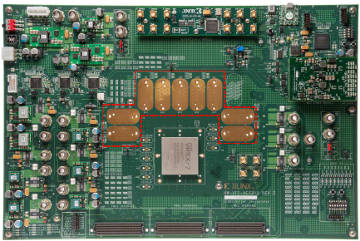
Project Overview
Equipment Used
FPGA VC7203
“Field-Programmable gate array”
Programmable device to develop and implement design
FMC connectors: transmit parallel data with a data rate up to 2 Gb/s (per channel)
GTX transceivers : transmit serial data up to 12,5 Gb/s
GTX transceivers
FMC connectors

Slide 6
Project Overview
Equipment Used
TB-FMCH-HDMI2
Receiver (image above) and Transmitter (Image below)
Receive and transmit data from sink and source
Integrated FPGA with 3 different configurations available
Connection to VC7203 FPGA through FMC connectors
GTX transceivers

Slide 7
Project Overview
Goals
Obtain a reliable communication between two HDMI devices:
Connect HDMI sink device with HDMI receiver board through an HDMI cable
Implement a design in the FPGA to receive data from HDMI board
Create packets of the incoming data and send it to the GTX transmitter
Receive the incoming data from the GTX receiver and re-organize it
Finally send it again to the HDMI transmitter board
Connect HDMI source device through an HDMI cable to transmitter board

Slide 8
Project Overview
Goals
3
4
1
6
2
5
Notes:
Connect HDMI sink device with HDMI receiver board through an HDMI cable
Implement a design in the FPGA to receive data from HDMI board
Create packets of the incoming data and send it to the GTX transmitter
Receive the incoming data from the GTX receiver and re-organize it
Finally send it again to the HDMI transmitter board
Connect HDMI source device through an HDMI cable to transmitter board

Slide 9
Project Overview
Goals
Goal
Step 1
Step 2
Project divided in two steps
Step 1: Obtain simple and direct communication between two HDMI exploring the boards different configurations
Step 2: Create a serial protocol and a design in the FPGA in order to connect data to GTX transceivers available in the FPGA
Notes:
In order to obtain a certain goal, we should split the whole project into two main steps

Slide 10
Project Overview
Goals – Step 1
Notes:
Obtain simple and direct communication between two HDMI exploring the boards different configurations

Slide 11
Project Overview
Goals – Step 2
Notes:
Create a serial protocol and a design in the FPGA in order to connect data to GTX transceivers available in the FPGA

Slide 12
Project Development
And some results

Slide 13
Step 1 – Development Generate and transmit COLOR BAR in FPGA to HDMI source
features
Design diagram
Generate a Color Bar in FPGA :
1920x1080 pixels
Refresh rate of 60 Hz
RGB images
10 bits for color
Control signals: vsync, hsync and enable
Pixel clock (148,5 MHz for FULL HD resolution)
Reset Button
To restart the whole system
Start Button
To star transmission of the color Bar
Notes:
DESIGN DIAGRAM:
->block generates color bar
FEATURES:
-> see features

Slide 14
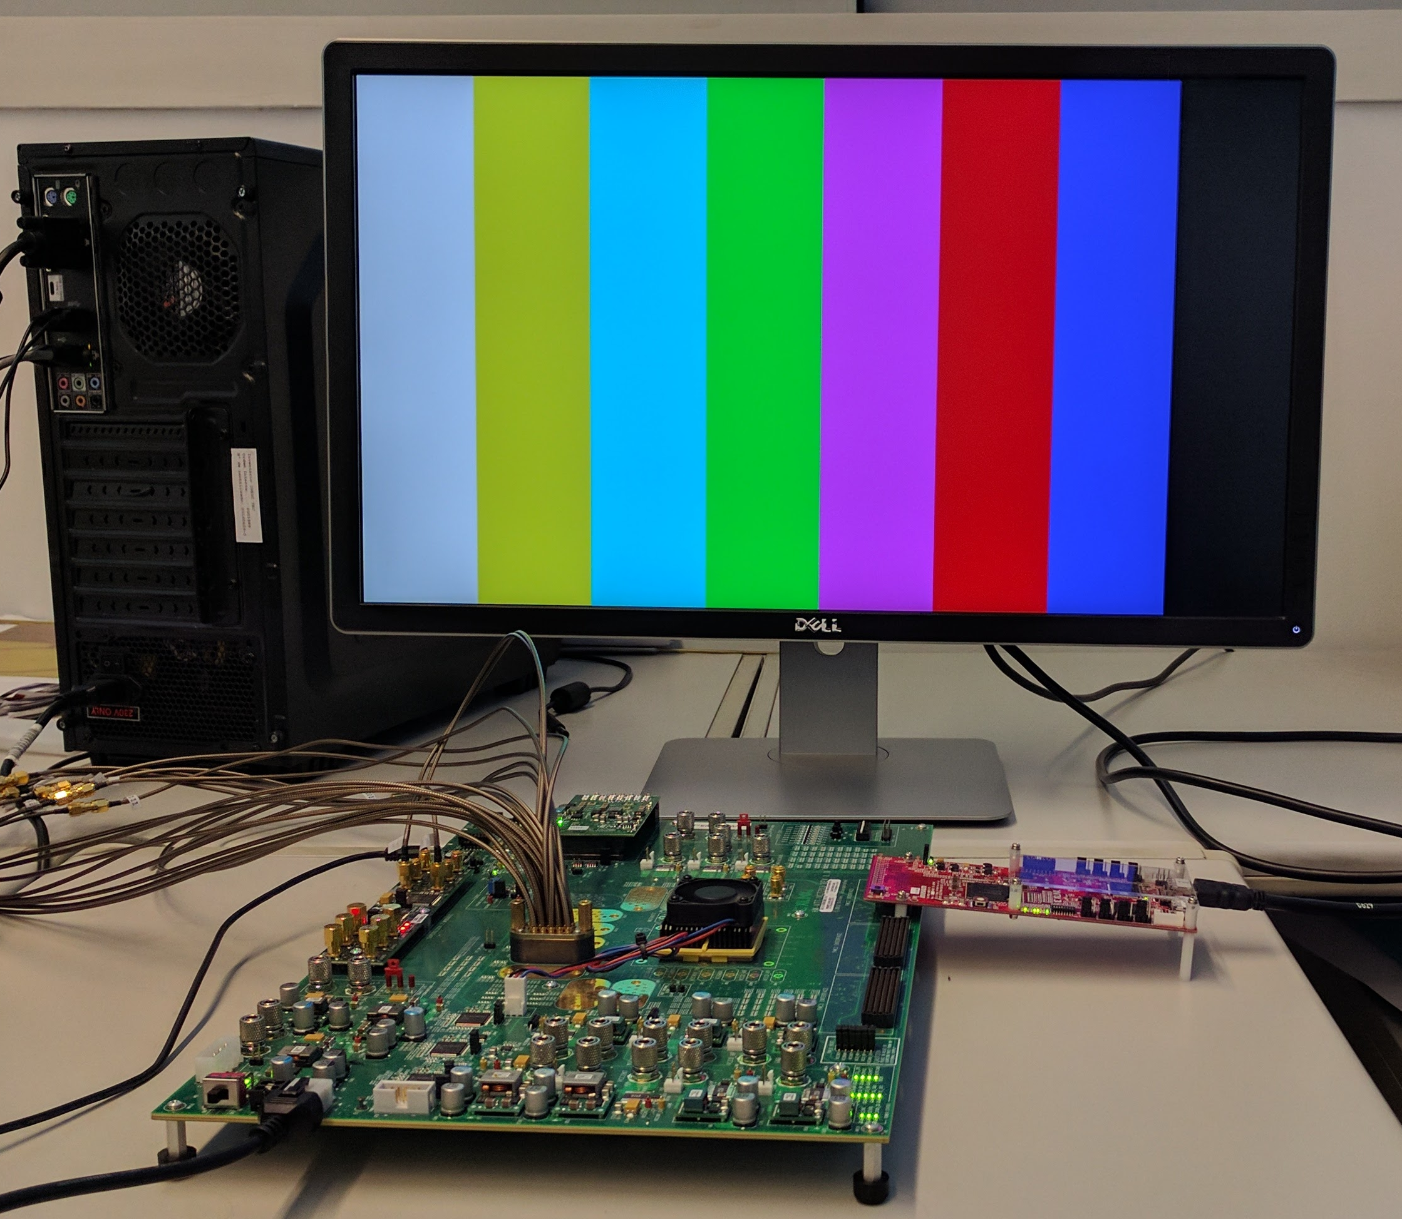
Step 1 – Results Generate and transmit COLOR BAR in FPGA to HDMI source
Test SETUP
Notes:
Resultados OK !!

Slide 15
Step 1 – Development Simple communication of image between HDMI devices
features
Generate a Color Bar in FPGA :
1920x1080 pixels
Refresh rate of 60 Hz
Transmit image from HDMI sink:
1920x1080 pixels
Refresh rate of 60 Hz
RGB images
10 bits for color
Control signals: vsync, hsync and enable
Pixel clock (148,5 MHz for FULL HD resolution)
Reset Button
To restart the whole system
Start Button
ON: transmit Color Bar
OFF: transmit image from HDMI sink

Slide 16
Step 1 – Development Simple communication of image between HDMI devices
Design diagram

Slide 17
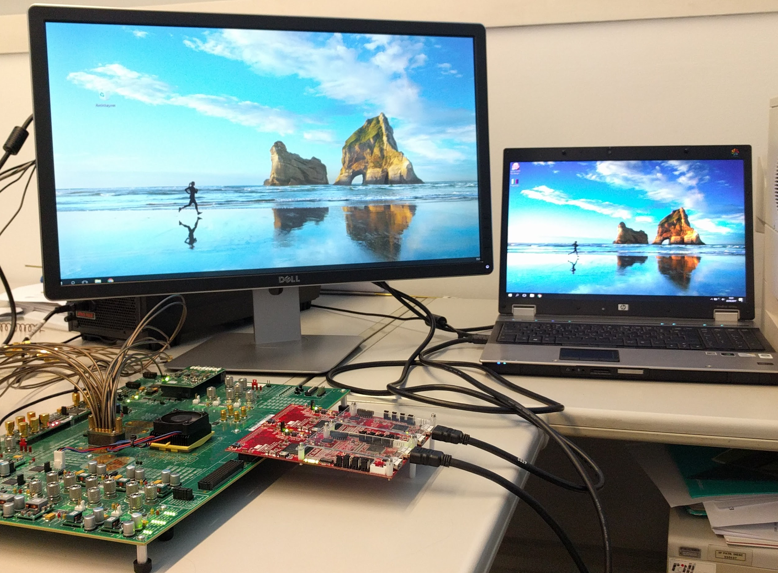
Step 1 – Results Simple communication of image between HDMI devices
rESULTS
Test SETUP
Notes:
TEST SETUP:
-> conection between HDMI sink device and HDMI receiver board
-> HDMI receiver connected to FPGA where the design is already implemented
-> FPGA sends signals to HDMI transmitter board
-> HDMI source device connected to HDMI transmitter board
RESULTS:
-> Results as expected: image sink device is sending correct signals to source device

Slide 18
Step 1 – Development Simple communication of image and sound between HDMI devices
features
Generate a Color Bar in FPGA :
1920x1080 pixels
Refresh rate of 60 Hz
Transmit image from HDMI sink:
1920x1080 pixels
Refresh rate of 60 Hz
RGB and YCbCr images
8/10/12 bits for color
Control signals: vsync, hsync and enable
Pixel clock (148,5 MHz for FULL HD resolution)
Transmit sound from HDMI sink:
Audio in format I2S
Reset Button
To restart the whole system
POWER Button
OFF: transmit Color Bar
ON: transmit image from HDMI sink
Mute Button
To mute the system
Notes:
This design transmitts image and sound.
See features in the slide

Slide 19
Step 1 – Development Simple communication of image and sound between HDMI devices
Design diagram
Test SETUP
Notes:
DESIGN DIAGRAM:
-> Sound data is sampled to register at pixel clock frequency, because audio clock in much lower than pixel clock;
-> Pixel clock = 148,5 MHz
-> Audio Clock = 3,072 MHz
-> Used 2-shift registers to sync data from different time domains
-> Multiplexer to select data to transmitt
-> Mux1: selects image data
-> Mux2: selects soud data
-> Data sent to HDMI TX
TEST SETUP:
-> conection between HDMI sink device and HDMI receiver board
-> HDMI receiver connected to FPGA where the design is already implemented
-> FPGA sends signals to HDMI transmitter board
-> HDMI source device connected to HDMI transmitter board

Slide 20
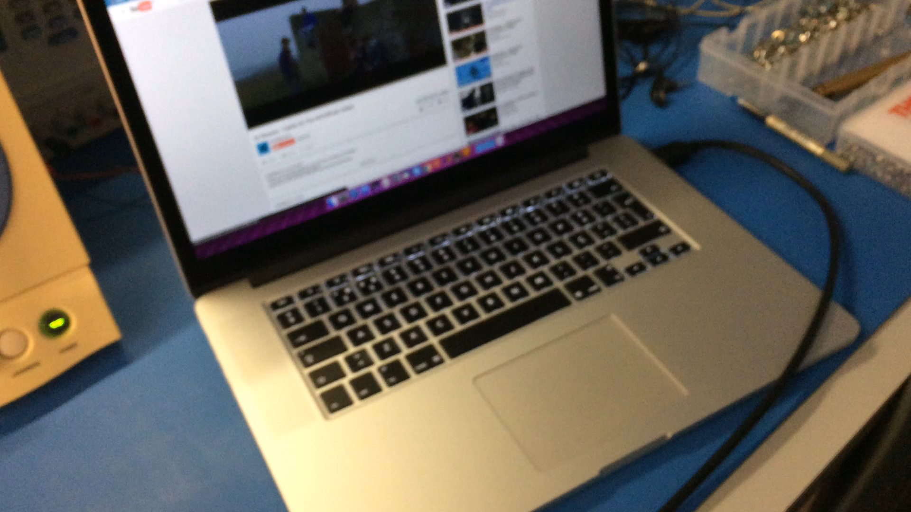
Step 1 – Development Simple communication of image and sound between HDMI devices
Notes:
RESULTS AS EXPECTED:
-> No problem with sound

Slide 21
Step 2 – Development Serial communication of color bar generated in FPGA and HDMI source
features
Generate a Color Bar in FPGA :
1920x1080 pixels
Refresh rate of 60 Hz
RGB images
10 bits for color
Control signals: vsync, hsync and enable
Pixel clock (148,5 MHz for FULL HD resolution)
Reset Button
To restart the whole system
Start Button
To start transmission of the color Bar
Create frames of 40 bits:
Each frame contains pixel value, hsync value, vsync value and enable value
Samples data at 148,5 MHz to TX
Each frame is send to the TX @ 148,5 MHz
Line Rate = 5,94 Gb/s
Receives data at 148,5 MHz from RX
Each frame is received from RX @ 148,5 MHz
Re-organize data received
Data needs to be re-organized when received from the RX
Notes:
See features in slide

Slide 22
Step 2 – Development Serial communication of color bar generated in FPGA and HDMI source
Design diagram
Notes:
DESIGN DIAGRAM:
-> Antes da serialização:
→ block that generates the color bar
→ Block that syncs the different domains clocks
→ Block that generates framesof 40 bits at 148,5 Mhz (FULL HD image)
-> GTX:
→ Sends data at 5,94 Gb/s
-> Depois de serialização:
→ Block that reorganizes the data received using SOF to do that
→ Block that extracts values of pixel. Vsync, hsync and enable from frame organized and send it to HDMI TX

Slide 23
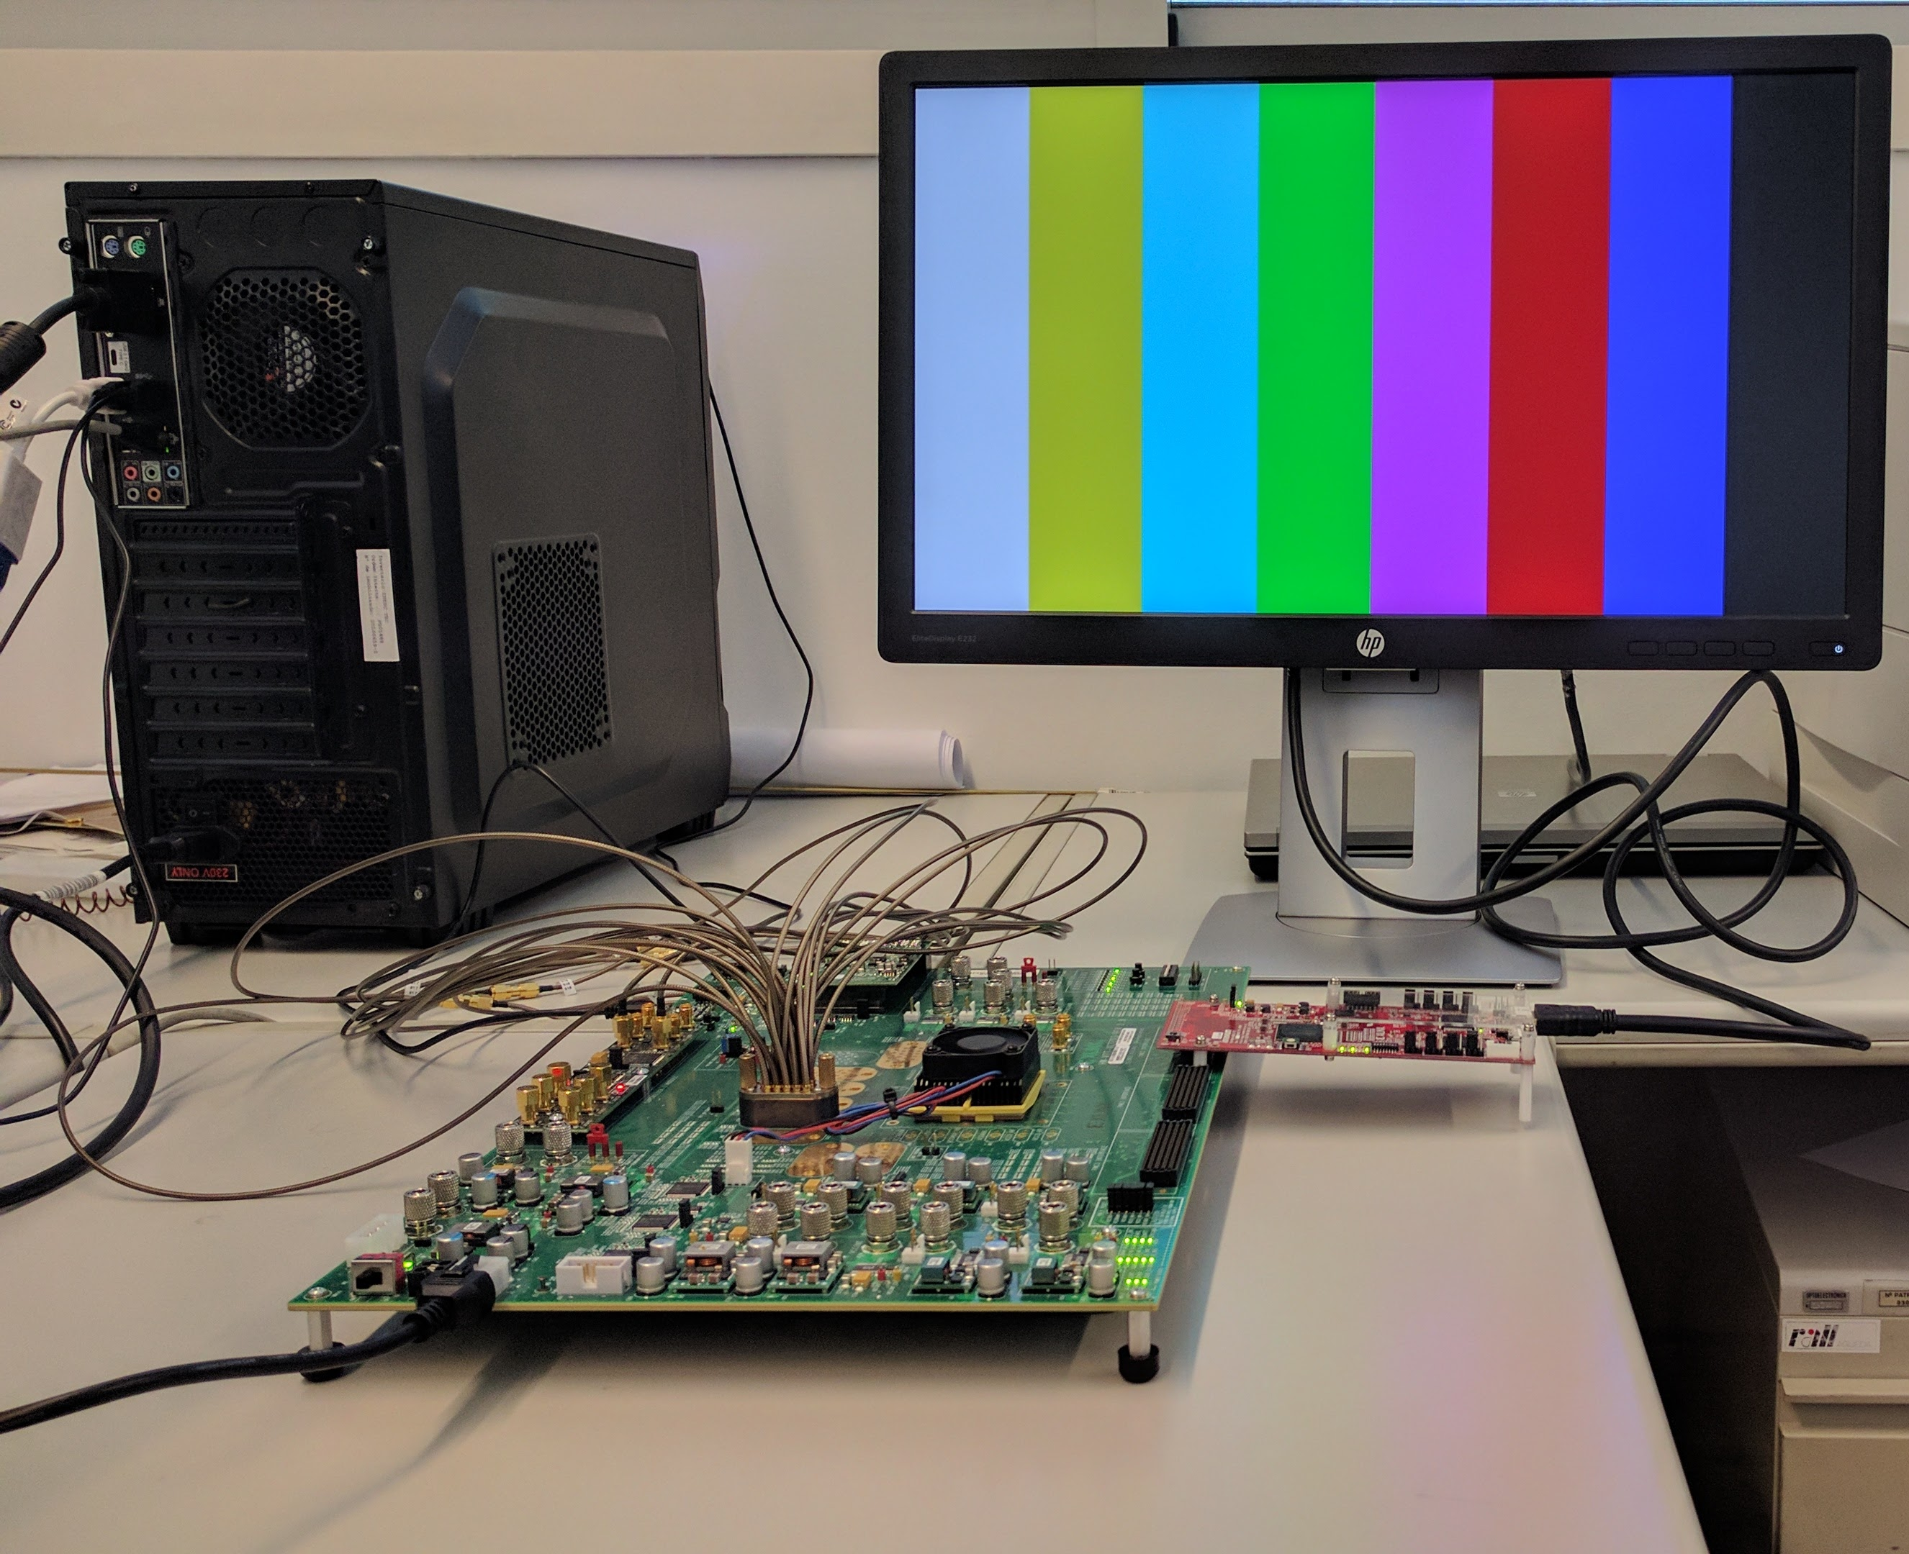
Step 2 – Results Serial communication of color bar generated in FPGA and HDMI source
Test SETUP
rESULTS
Notes:
TEST SETUP:
-> equal to previous but now connected SMA CABLE to transmit serial data
RESULTS:
-> a expected

Slide 24
Step 2 – Development Serial communication of image between HDMI sink and source
features
Generate a Color Bar in FPGA :
1920x1080 pixels
Refresh rate of 60 Hz
RGB images
10 bits for color
Control signals: vsync, hsync and enable
Pixel clock (148,5 MHz for FULL HD resolution)
Transmit image from HDMI sink:
1920x1080 pixels
Refresh rate of 60 Hz
Reset Button
To restart the whole system
Start Button
ON: transmit Color Bar
OFF: transmit image from HDMI sink device
Create frames of 40 bits:
Each frame contains pixel value, hsync value, vsync value and enable value
Samples data at 148,5 MHz to TX
Each frame is send to the TX @ 148,5 MHz
Line Rate = 5,94 Gb/s
Receives data at 148,5 MHz from RX
Each frame is received from RX @ 148,5 MHz
Re-organize data received
Data needs to be re-organized when received from the RX

Slide 25
Step 2 – Development Serial communication of image between HDMI sink and source
Design diagram
Notes:
DESIGN DIAGRAM:
-> Antes da serialização:
→ block that generates the color bar
→ Block that syncs the different domains clocks
→ Block that generates framesof 40 bits at 148,5 Mhz (FULL HD image)
-> GTX:
→ Sends data at 5,94 Gb/s
-> Depois de serialização:
→ Block that reorganizes the data received using SOF to do that
→ Block that extracts values of pixel. Vsync, hsync and enable from frame organized and send it to HDMI TX

Slide 26
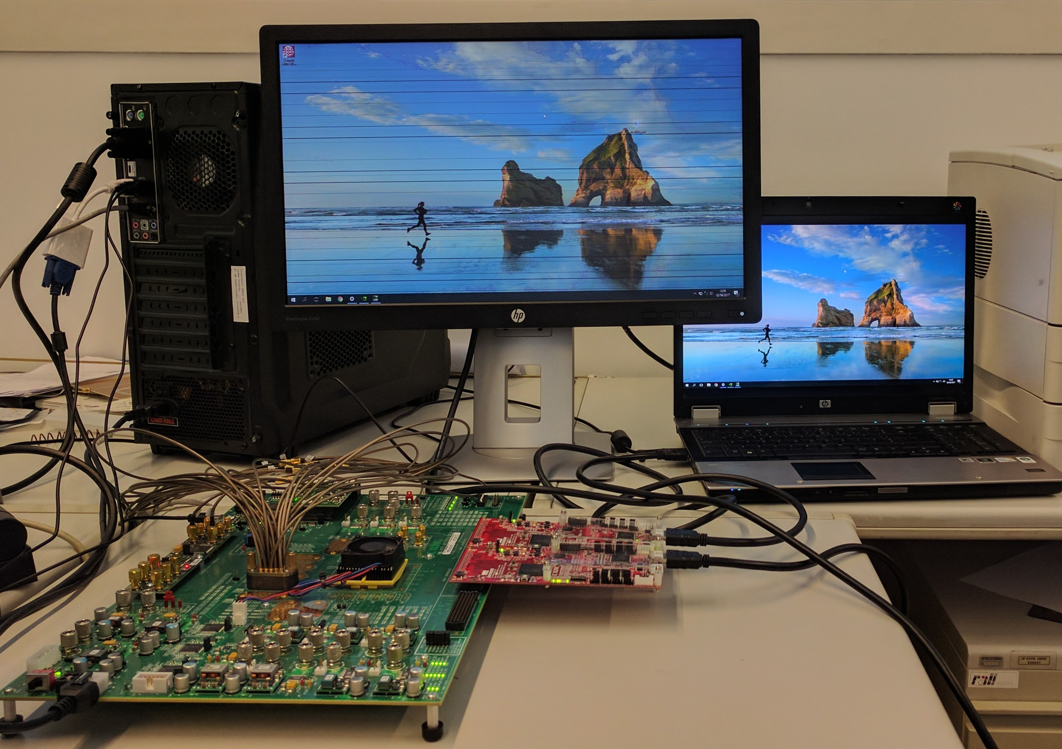
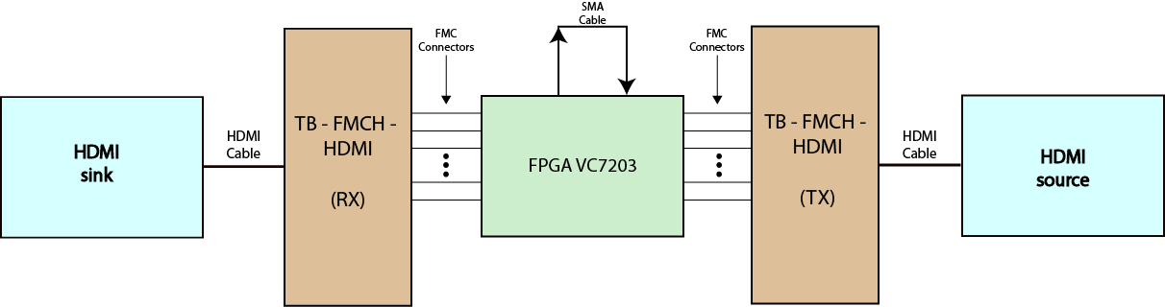
Step 2 – Results Serial communication of image between HDMI sink and source
Test SETUP
rESULTS
Notes:
TEST SETUP:
-> equal to previous but now connected SMA CABLE to transmit serial data
RESULTS:
-> syncronization problem (horizontal syncronization)

Slide 27
Conclusions
And future work

Slide 28
Main Conclusion and Future Work
Hdmi back-to-back link
Serial communication
Almost configurations available for HDMI boards were explored:
Just image in RGB format
Image in RGB and YCbCr format and Sound
All the work of major importance was accomplished in this field
Future work:
Explore two channels of HDMI data and work on some configurations with that
Serial Communication was achieved
Available to achieve 5,94 Gb/s
Other data rates are achievable for other configurations
Future work:
Transmit Sound with image too
Work on the packing protocol and get better results

Slide 29
Thank you
Any Questions ?

